Slide 1
Spicely
“Sugar, Spice and Everything Nice”
Team 31

Slide 2
0.
The Team
Meet the crew….

Slide 3



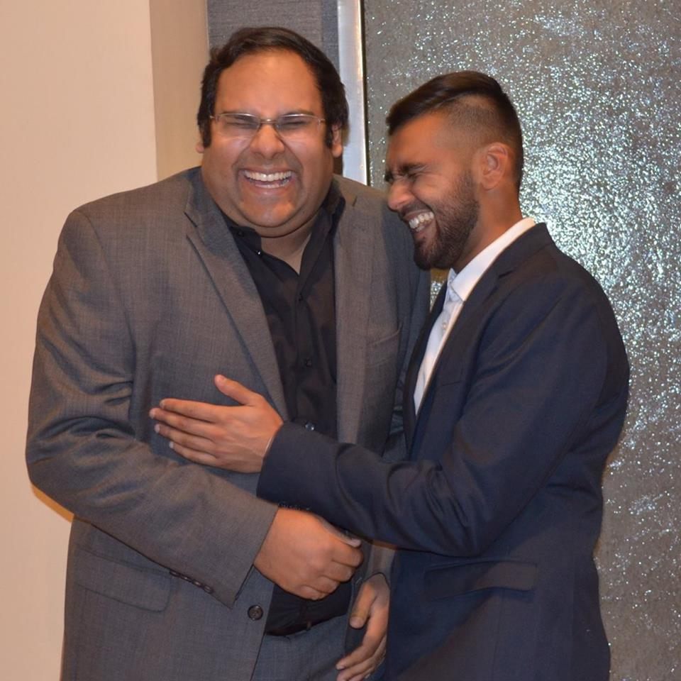
TEAM MEMBERS
Jack Li
Jabr Abumaali
John Wu
Srishti Pal
Krish Kabra
2nd Year
Electrical Engineering
UCLA
Graduate
Physics UCLA
CS Graduate Student,
NYU
Applied Math, UCLA
1st Year
Computer Science and Engineering
UCLA
3rd Year
Physics
UCLA

Slide 4
1.
The Problem
Why is cooking so hard?

Slide 5
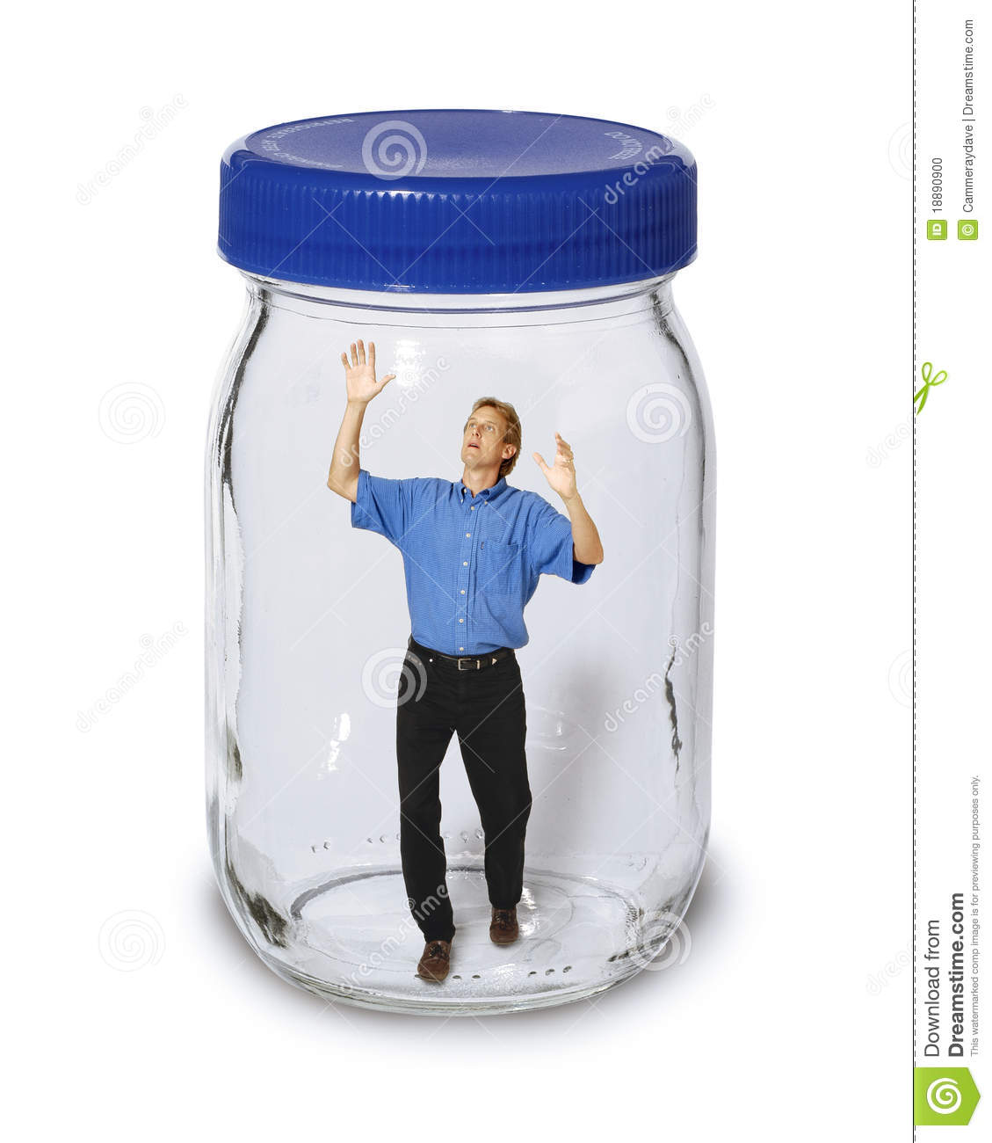
A MESS IN THE KITCHEN
Too many ingredients
Need to be measured precisely
Countless recipes to choose from
Need to remember recipes
Notes:
Have you ever walked your kitchen, and stared directly into your food cabinet for 5 minutes,

Slide 6
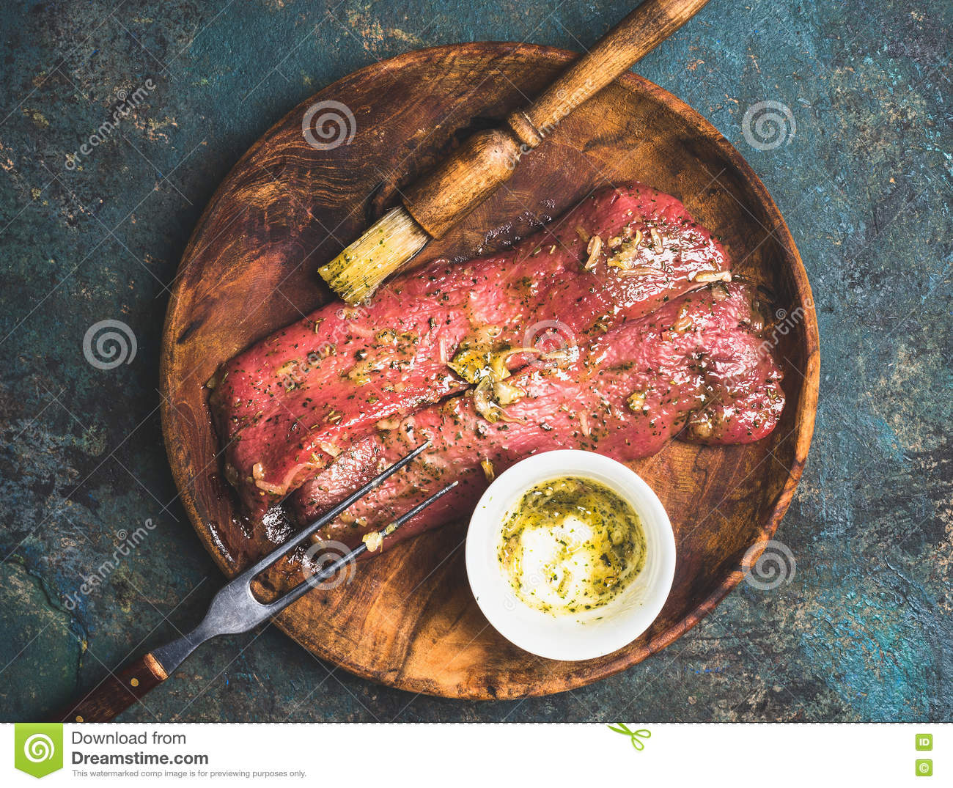
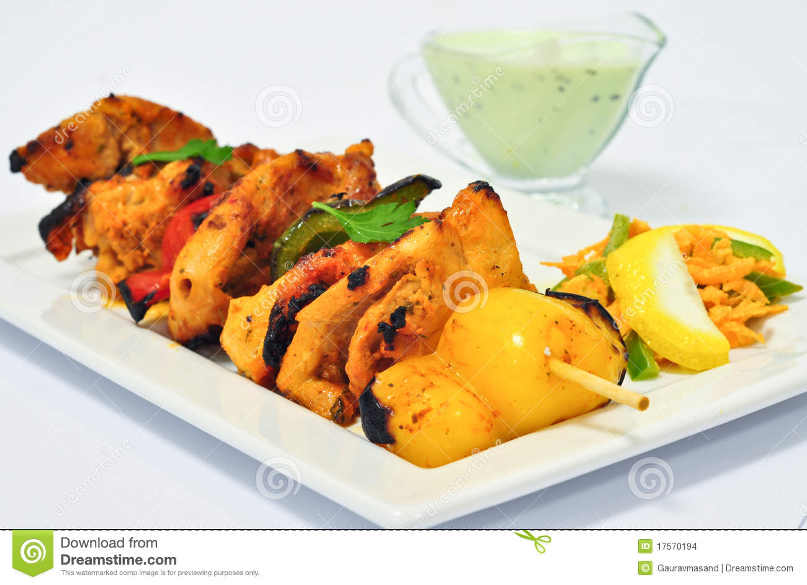
“Basic” BBQ Rub
Chicken Tikka
2 teaspoons garlic powder
2 teaspoons onion powder
2 teaspoon celery seeds
1 teaspoon cayenne pepper
1/4 cup firmly packed brown sugar
1/4 cup sweet paprika
3 tablespoons black pepper
3 tablespoons coarse salt
1 tablespoon hickory-smoked salt or more coarse salt
6 teaspoons coriander.
6 teaspoons cumin.
6 teaspoons garlic powder.
6 teaspoons paprika.
4 teaspoons garam masala.
3 teaspoons ginger, ground.
3 teaspoons dried mint.
2 teaspoons chili powder.
Notes:
A quick google search for recipes of common dishes involving spice-rubs leads to a shocking realization:
You need to own a large number of spices and seasonings
You need to measure out

Slide 7
2.
The Solution
Preparation & Cooking made easier...

Slide 8
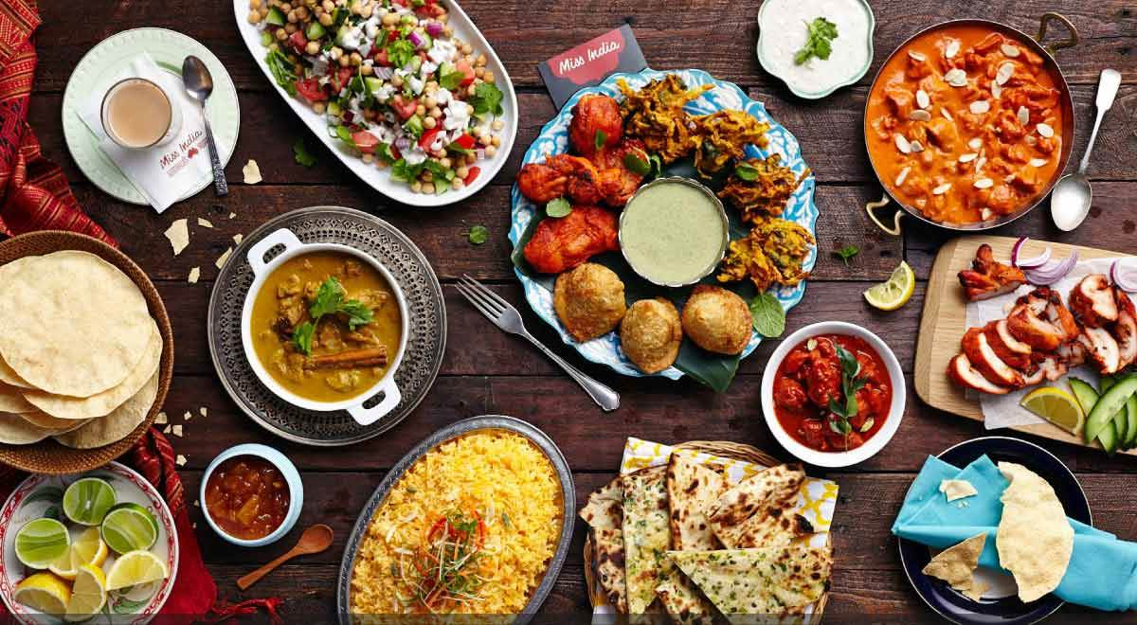
ALL YOUR RECIPES,
ONLY THE PRESS OF A BUTTON AWAY

Slide 9
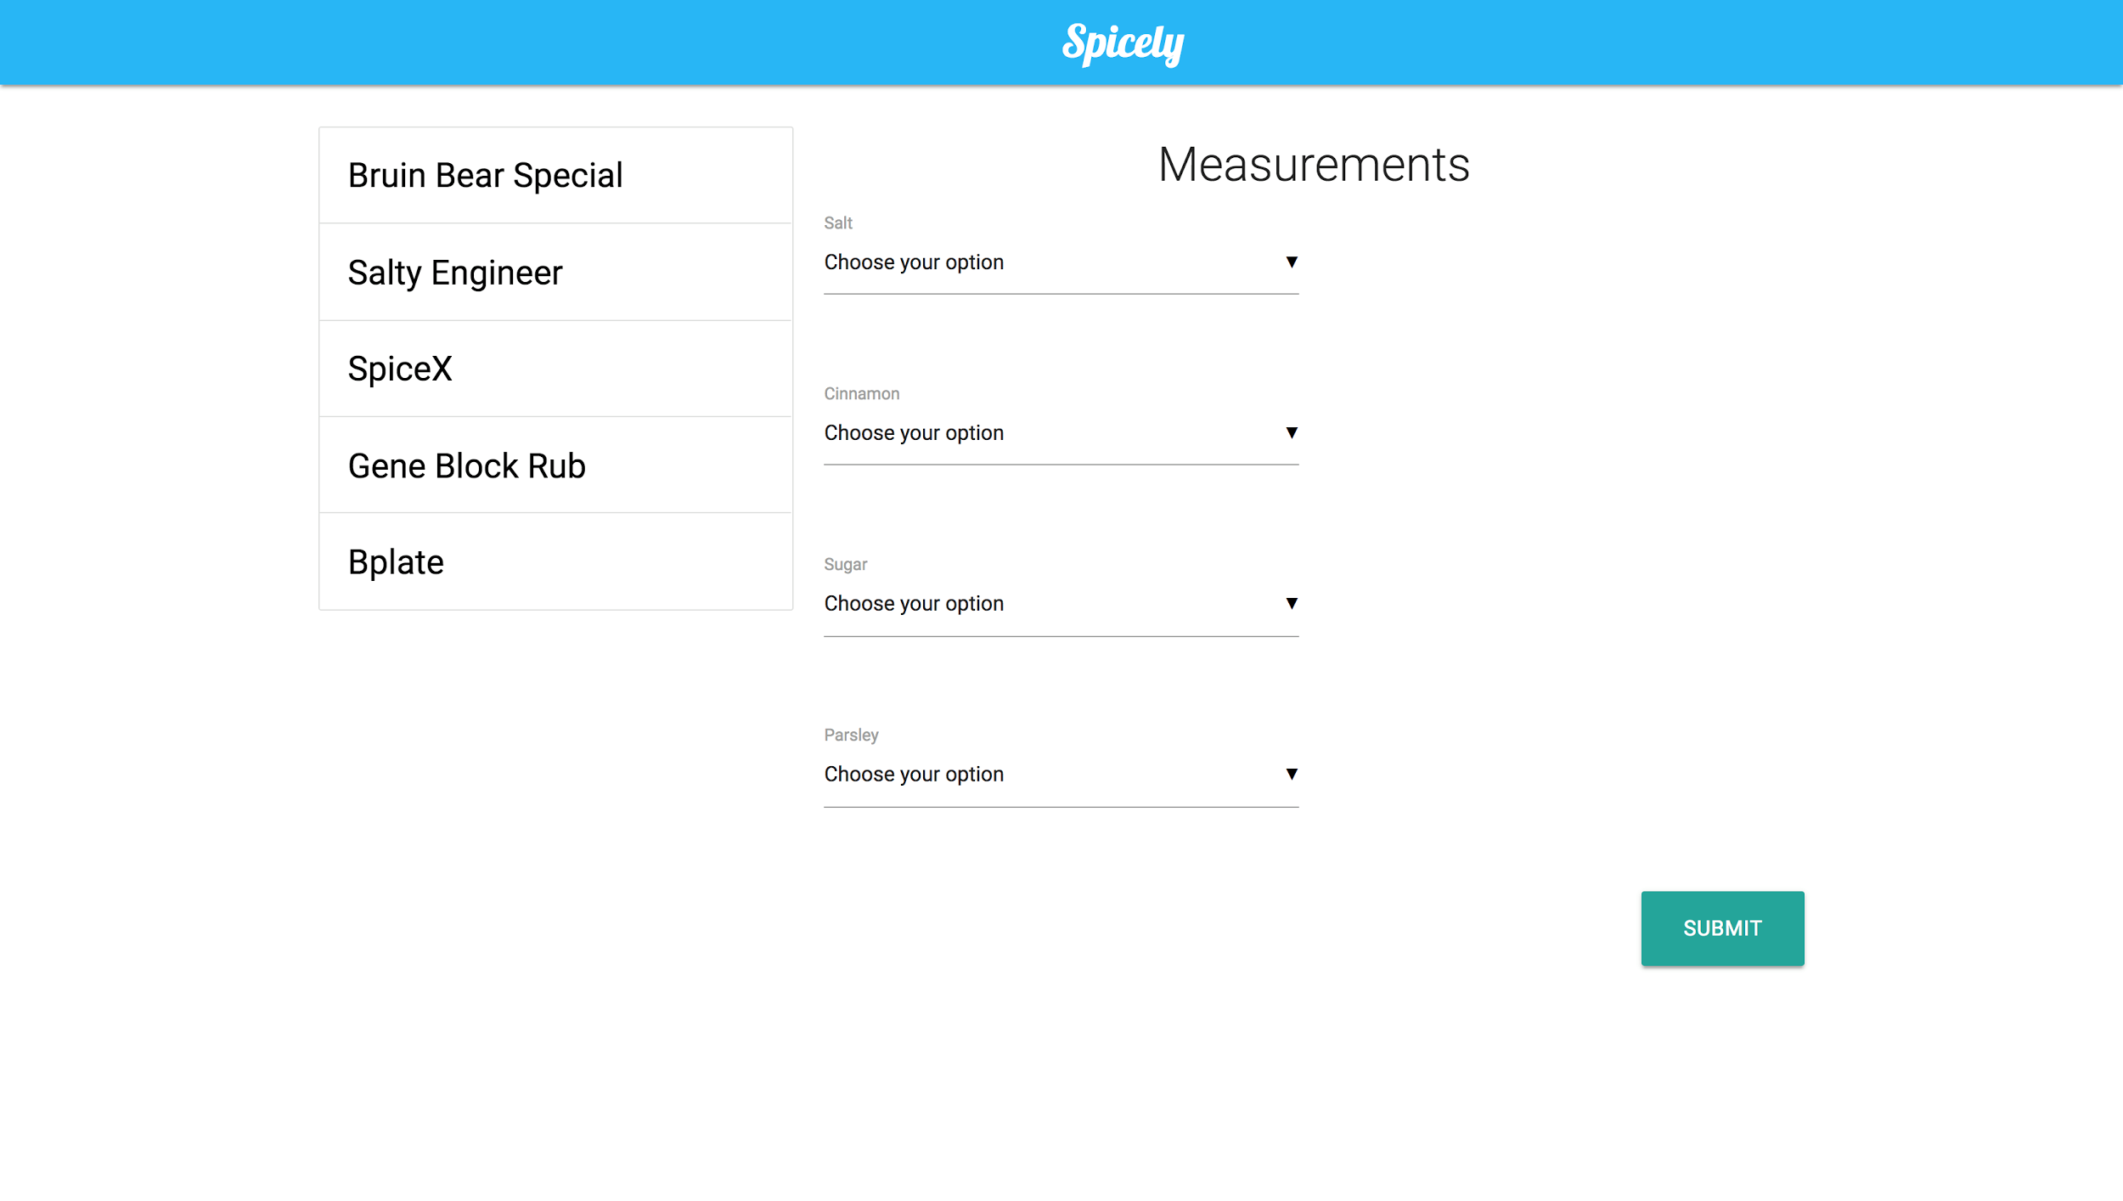
DESKTOP Web App

Slide 10
Design
Spice Rack
Arduino
User Interface
(Web App)
Motor controlled dispenser
Output

Slide 11
Contributions
John Wu
Jabr Abumaali
Jack Li
Krish Kabra
Srishti Pal
> Hardware
> Team Coordination
> Arduino
> Calibration
> Future potential and applications
> Web app using node.js
> Integration between Arduino and node
> Calibration
> Circuit assembly
> Dispensing mechanism
> Arduino

Slide 12
3.
The Future
Please give us more than 36 hours…

Slide 13
Future Potential
Hardware
More spices, sauces
More precise measuring system
Sleeker design
Mixing/rubbing mechanism
Grinder mechanism
Spice level measurement
Software
Larger library of recipes to choose from (websites, cookbooks, etc)
Save recipes and usage history
Recipe suggestions based on user preferences
Mobile app with support for smartwatches
Notify low spice levels, link with Amazon Marketplace
Voice Control/Gesture recognition for better accessibility
Internet of Things
Link up with Google Home, or Alexa
Complete food automation

Slide 14
Thank You!
Questions?

